Slide 1
Generating Attacks Auto-Diagrams
Project Extension by Shachar Gabbay
Meeting 1
Based on the work of: Chen Dar, Karin Yechilzuke, and Ahmad Khalila

Slide 2

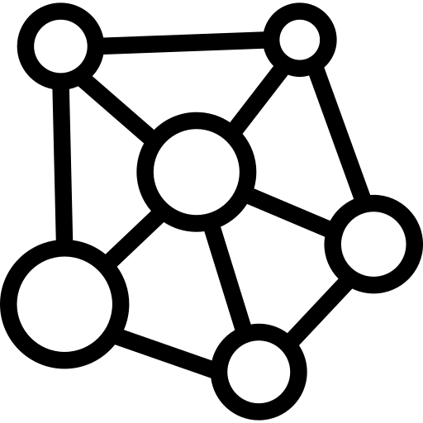

Literature Review
Visualization of Network Traffic
Attack Trees and Attack Graphs
LLM + Diagram Generation
Notes:
Nodes = attacker states, capabilities, or goals
Edges = exploit steps or transitions

Slide 3
Network Visualization - Packet to Diagram
Wireshark Flow Graph
VisualEther
PCAPXray/PCAPMap
SolarWinds

Slide 4
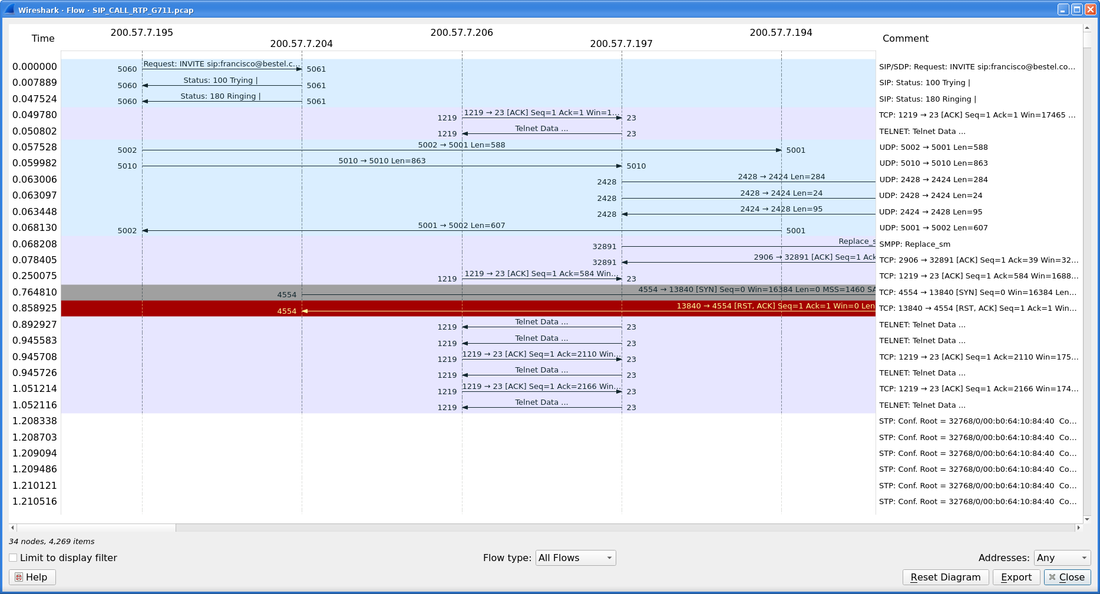
Network Visualization - Packet to Diagram
Wireshark Flow Graph
Not diagrams but:
Mostly for troubleshooting
Shows connections between hosts and packet details
Filters all connections by different options

Slide 5

Network Visualization - Packet to Diagram
VisualEther - Protocol Analyzer
Converts PCAP files to UML diagrams
Literal mapping of packets
Used for low level debugging
Does not explain intent or protocol-level meaning

Slide 6
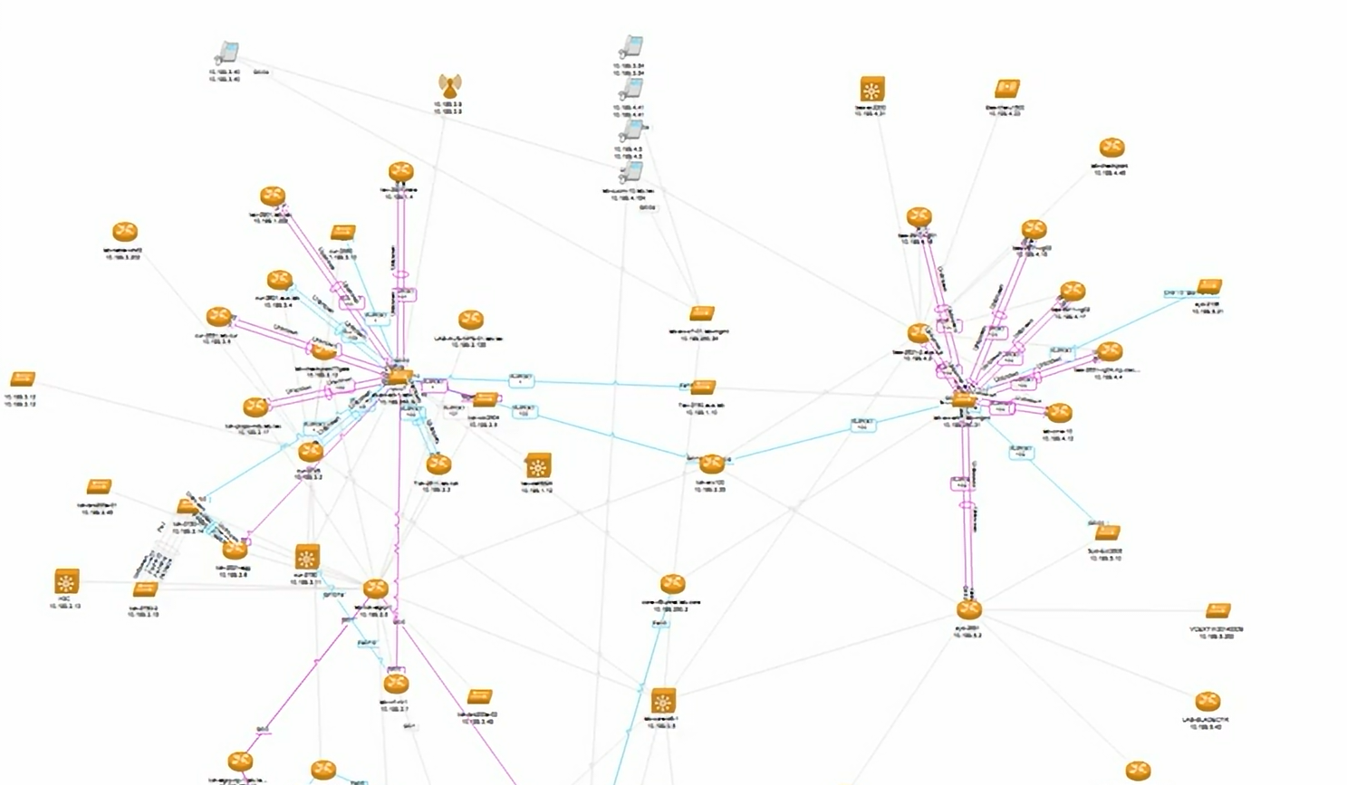
Network Visualization - Packet to Diagram
SOLARWINDS PcapXray
Gives full network of PCAP
Network mapping software built to automatically plot network topology
Visual Summaries of network behavior

Slide 7
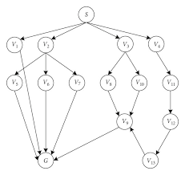
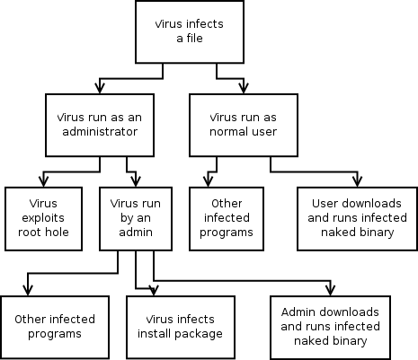
Attack Trees and Attack Graphs
Based on logical rules and specific configurations
MulVAL
MAL
SafeBreach

Slide 8
Attack Trees and Attack Graphs
MulVAL - Multi host, multi-stage Vulnerability Analysis tool
Takes security scans and network configs
Based on predefined logic rules
Attack graphs generator - industry standard
Shows attackers possible steps
Notes:
אתה נותן לו:
תצורת רשת
חולשות ידועות (CVEs)
הרשאות, שירותים, חוקים
והוא בונה:
Attack Graph שמראה
שמראה איך התוקף יכול להתקדם במערכת
כלי אקדמיים
המנוע הלוגי של MulVAL מנתח את הפגיעויות ברשת ומוצא את כל הדרכים שבהן תוקף יכול להתקדם.
מוכיח מתקפות
בעזרת כלי חיצוני בשם GraphViz, ה-MulVAL הופך את קובץ ה-DOT לתמונה (PDF או PNG) של גרף מורכב עם עיגולים ומרובעים המייצגים צעדי תקיפה ותנאים מוקדמים

Slide 9
Attack Trees and Attack Graphs
MAL – Meta Attack Language
Framework for building languages for attack simulations
Creates Attack trees describing methods to attack networks
Top node is the goal of the attack
Branches are different ways to get there
Notes:
uses "Attack Step" logic to generate a probabilistic attack graph
הלוגיקה: מבוססת על עצים המחוברים בשערים לוגיים (כמו AND/OR) וחישובי הסתברות.
התוצאה: עצי תקיפה המראים את הדרכים השונות שבהן ניתן לפרוץ למערכת המודל.
Risk Assesment
גרף המראה לא רק את המסלול, אלא גם את ההסתברות שהתוקף יצליח בכל שלב.
הם טובים לניתוח סיכונים (מה עלול לקרות). פחות להסבר אקדמי (מה קרה ואיך הפרוטוקול עבד).

Slide 10
Attack Trees and Attack Graphs
SafeBreach – Breach and Attack Simulation
Market leading platform for security validation
Uses a library of attack methods
Diagrams showing how an attacker can move in the network to reach assets.
Focuses on simulated attack paths, not observed traffic
Notes:
מדמה מתקפות סייבר בתוך אירגון כדי לבדוק אם ההגנות באמת עובדות
מריץ מתקפות מדומות
מראה דיאגרמות של איך התוקף יכול לנוע ברשת
לא כלי מחקרי
לא מסתכל על חבילות אמיתיות
לא יודע להגיד:
איזה packet גרם לאיזה שלב
מתי בדיוק זה קרה
איך הפרוטוקול התנהג
כלומר: הוא אסטרטגי, לא פורנזי.

Slide 11



LLM + Diagram Generation
Eraser.io
Selector.ai (waiting for demo)
MiroAI (waiting for demo)
GitHub CoPilot

Slide 12

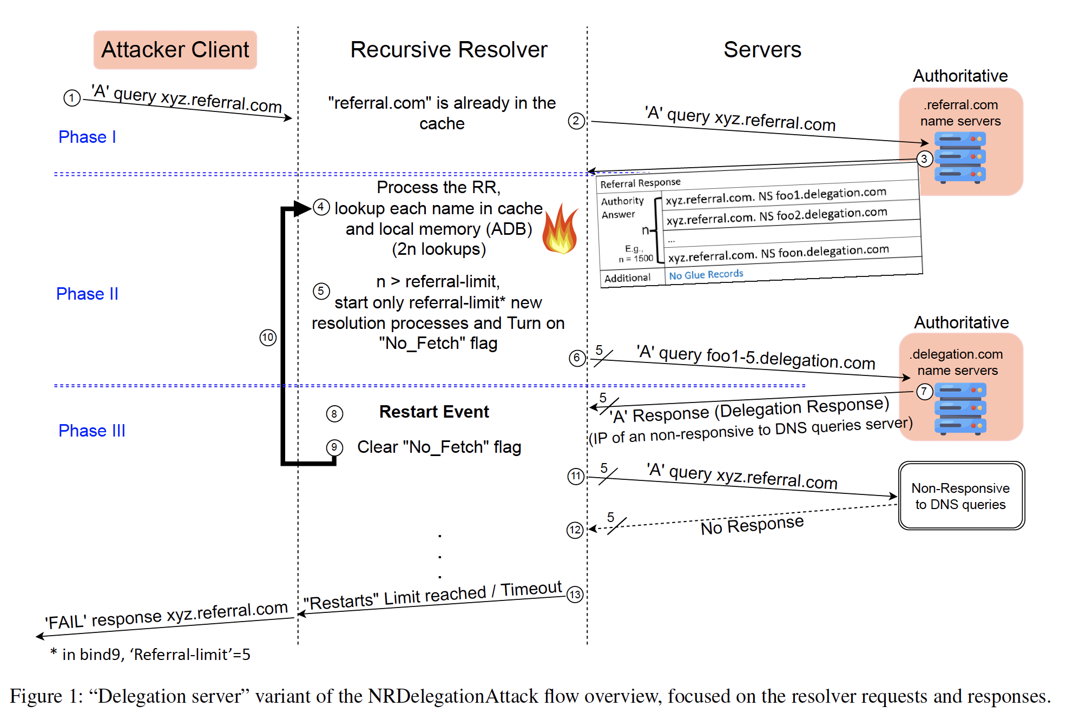
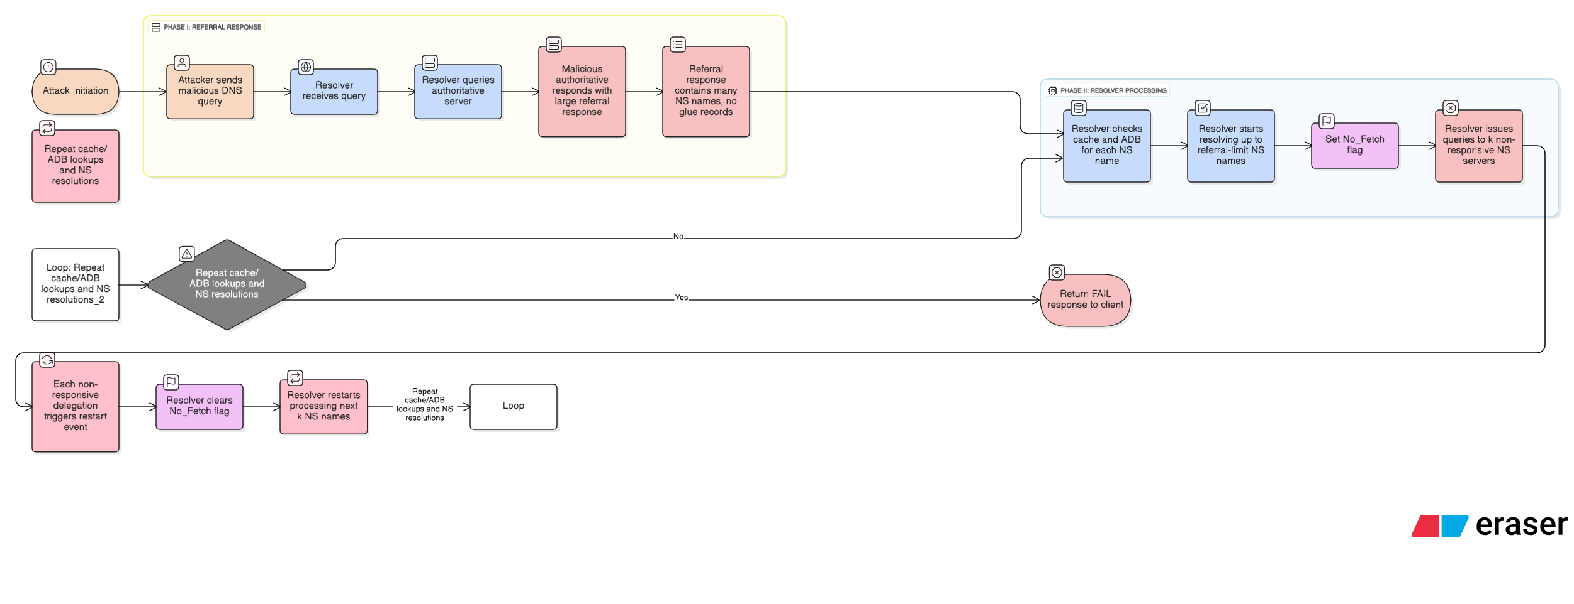
LLM + Diagram Generation
Eraser.io – AI for Technical design and documentation
Industry leader for AI diagram creation
Editing through feedback loop
not supporting .PCAP
Not specified for networks but for general diagrams

Slide 13

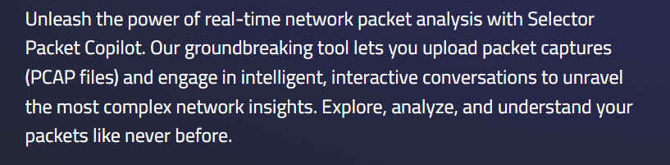
LLM + Diagram Generation
Selector.ai (packet copilot)– AI built for networks and allows “chatting” with PCAP
More suited for network troubleshooting than research.
Not supporting papers
Not specified for networks but for general diagrams

Slide 14
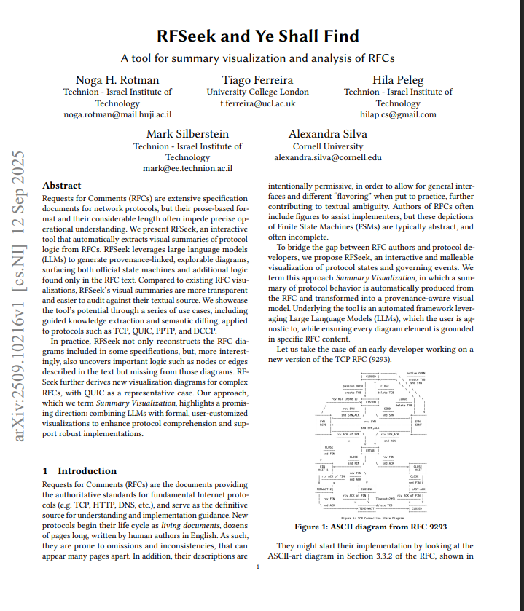
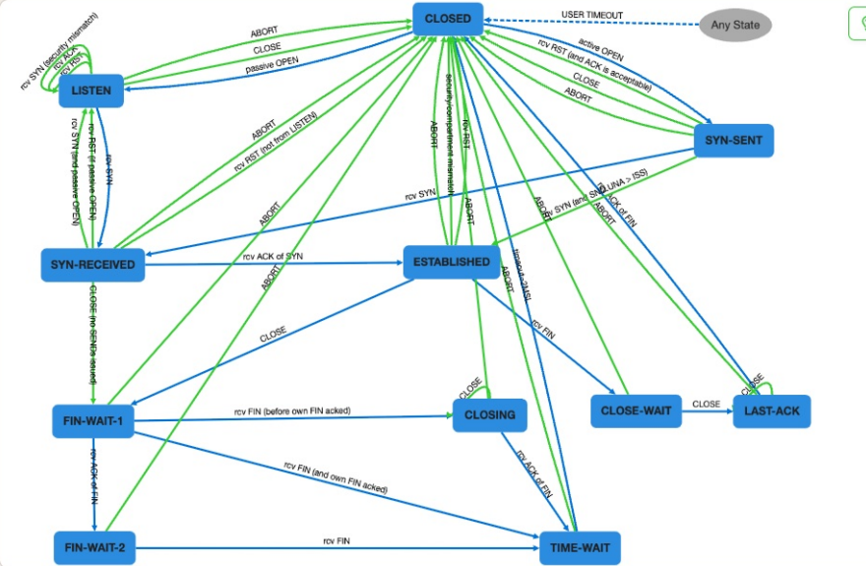
RFSeek and Ye shall Find
RFSeek and Ye shall Find
Automated Visual summaries of protocol logic
Visualizes protocol state machines from specs
Not specific to attack flow description
Notes:
Sep 2025
“We present RFSeek, an interactive tool that automatically extracts visual summaries of protocol logic from RFCs. “

Slide 15
Current Project Advantages and Abilities
Auto-Generation of draft diagrams for new papers and slides
Supports multiple file types and multiple PCAP analysis options
Export + chat interface enables manual polishing and iteration
Interactive storyboard + feedback loop

Slide 16
Motivation for Extension and Suggestions
Content density reduction
Post-processing and polishing for publication
Improved and configurable animations
Extension to protocols beyond DNS
Data specification
Controllable abstraction (researcher, student, reviewer…)
Grounding diagrams to packet-step level
Performance optimization and caching
Concrete evaluation of results
Notes:
שליטה ברמת ההפשטה

Slide 17
Data Specifications
Learning better network related diagrams styles using:
RAG
Fine-Tuning
Specific Protocols and network rules
Vocabulary of network attacks
Specific shape that better fits specific systems
Existing Datasets:
CyberLLMInstruct
NetFlow Statistics
PCAP-to-Text
Manually created diagrams

Slide 18
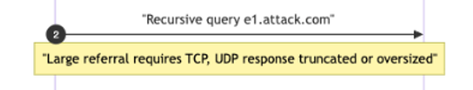
Grounding to Evidence
Event: UDP DNS referral response
Size: 1532 bytes
Evidence: packets #417- #421
Time: 2.18 - 2.24 s
Add verifying metadata and referral to timestamp in PCAP + redirection to line in PCAP
Notes:
פחות מידע אבסטרקטי ויותר הכוונה מדויקת לפרמטרים בטקסט/PCAP
traceability

Slide 19
Controllable Abstraction
Adapting abstraction level using a slider/prompt - “zoom in” to nodes
Low Abstraction
literal packet description
no explanation
High Abstraction
collapsing groups of packets
to conceptual actions
0%
50%
100%
Some Queries (less details)
Including evidence + concepts
Notes:
0% – Analyst / Debugging
Packet-level, timestamps, flags
50% – Researcher
Evidence + protocol concepts
100% – Student / Reviewer
Conceptual attack stages

Slide 20


Results Evaluation
Quantitative Evaluation
Syntax Correction: Mermaid CLI
Structural Fidelity: GED, DiagramEval
Metrics: Precision/Recall, F1-score
Researcher Review
Creating manual metrics and a poll for researchers to rank diagrams quality
Verifiability of diagrams
Qualitative
Satisfying Density Ratio (Packets/Node)
Clarity
Precision = $\frac{8}{10}$
Ground Truth
12 protocol events
Diagram shows 10
Recall = $\frac{8}{12}$
8 are correct
F1 ≈ 0.73
Notes:
DiagramEval: Evaluating LLM-Generated Diagrams via Graphs
Syntax Correctness: Use a "Mermaid Linter" or the Mermaid CLI to automatically check if the generated code is valid. A failed render is a 0% score for that run.
Precision/Recall: Are all the essential packets from the Pcap represented in the diagram?
F1-Score: Does the sequence of "who talked to whom" match the actual protocol flow?
Syntax Correctness: Use a "Mermaid Linter" or the Mermaid CLI to automatically check if the generated code is valid. A failed render is a 0% score for that run.
Precision = 8/10 Of the events the diagram shows, how many are correct?
Recall = 8/12 Of the events that actually happened, how many did the diagram capture?

Slide 21
Performance Optimization
Caching methods – to be searched in the future
Parallel Processing
Efficiency of mermaid code
Filtering only relevant packages
Notes:
עיבוד מקבילי של קובץ ה-PCAP (Parsing) במקביל לניתוח הטקסטואלי של המאמר האקדמי, מה שמקצר את זמן ההמתנה הכולל של המשתמש.
במקום לשלוח את כל ה-PCAP ל-LLM, המערכת מסננת "רעשי רקע" (כמו Keep-alives או תעבורת TCP שגרתית) ומשאירה רק את החבילות הרלוונטיות למתקפה. זה חוסך זמן עיבוד יקר.

Slide 22
Technology Comparison
Features | Traditional Tools | AI Generators | Extended Auto – Diagram
Input Source | Configs, PCAPs, manual input | PDF/Images/Prompts | PDF/PCAP/Prompts (hybrid)
Logic | Configs, manual decisions and Protocols | Unspecified LLM knowledge | LLM general knowledge + Fine tuning on
Security awareness | Depends on inserted protocols and configs | Not specifically networks aware | Specified data related to security and networks
Abstraction | Sometimes too technical, manual abstraction control | Visually polished graphs with static shapes | Controllable abstraction, Conceptual related blocks
Evaluation support | None | None | Quantitative/Qualitative

Slide 24
Meeting 4
Fixing Loops
Loops can only start at step I and end at step j
Researcher Review
Creating manual metrics and a poll for researchers to rank diagrams quality
Verifiability of diagrams
Qualitative
Satisfying Density Ratio (Packets/Node)
Clarity
Precision = $\frac{8}{10}$
Ground Truth
12 protocol events
Diagram shows 10
Recall = $\frac{8}{12}$
8 are correct
F1 ≈ 0.73
Notes:
DiagramEval: Evaluating LLM-Generated Diagrams via Graphs
Syntax Correctness: Use a "Mermaid Linter" or the Mermaid CLI to automatically check if the generated code is valid. A failed render is a 0% score for that run.
Precision/Recall: Are all the essential packets from the Pcap represented in the diagram?
F1-Score: Does the sequence of "who talked to whom" match the actual protocol flow?
Syntax Correctness: Use a "Mermaid Linter" or the Mermaid CLI to automatically check if the generated code is valid. A failed render is a 0% score for that run.
Precision = 8/10 Of the events the diagram shows, how many are correct?
Recall = 8/12 Of the events that actually happened, how many did the diagram capture?

Slide 25
Problems
Using full PCAP is choking the model, diagram is cut. Using pcap summaries instead – Adding packet extraction.

Slide 26
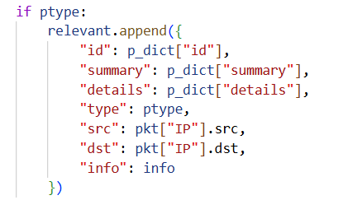
Packet Extraction – Limited Context Window
Noise Removal:
Remove Packets that have no IP layer (2nd layer, ARP)
Remove ICMP layers
Fingerprint:
TCP: Flags + Dport
UDP: Dport
DNS: Domain name
Pattern Finding:
Pick at most sampling_limit packets with the same fingerprint
Output a packet dictionary
SRC is not informative because it can change dynamically + add timestamp

Slide 27
Until Next Time!

